Slide 1
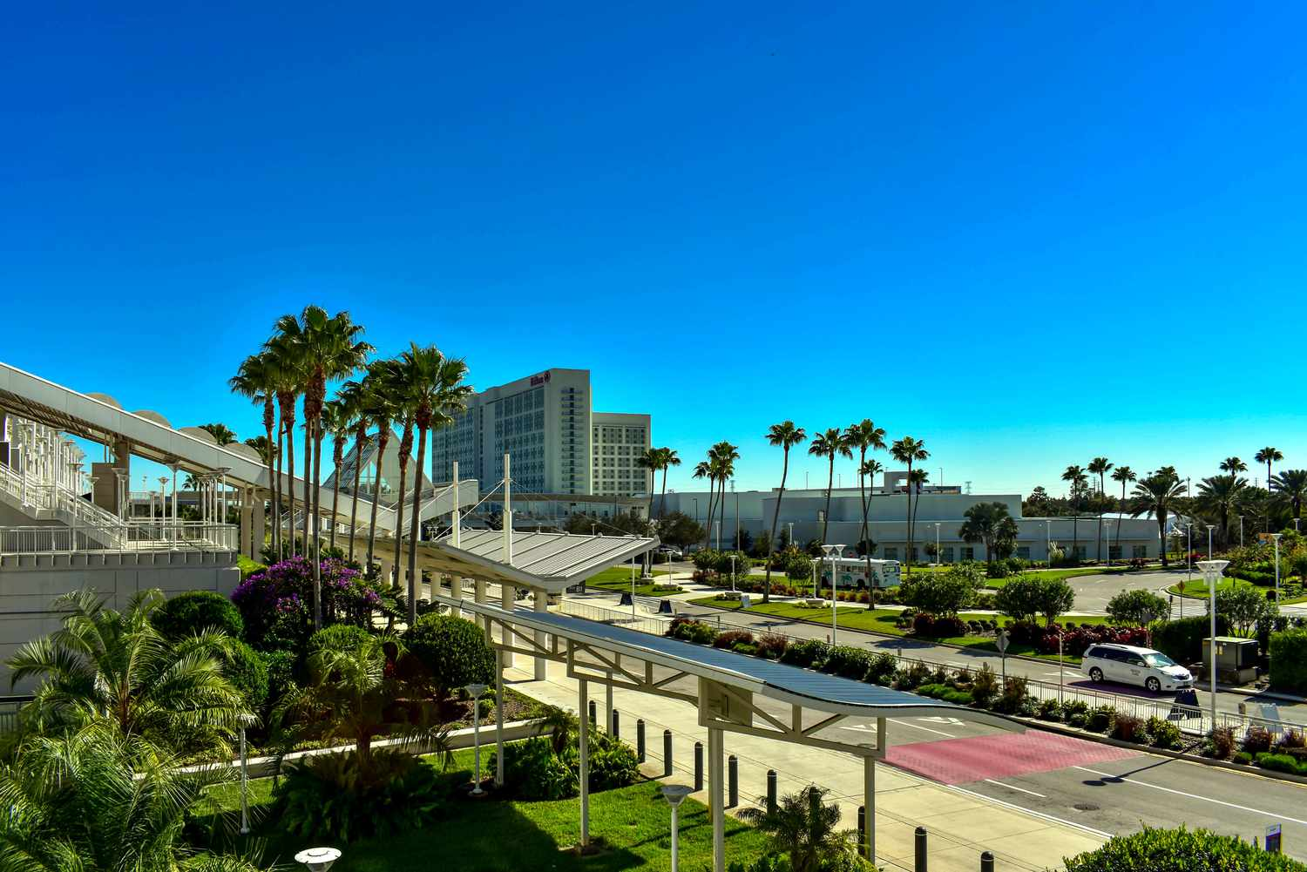
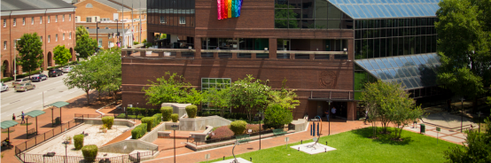
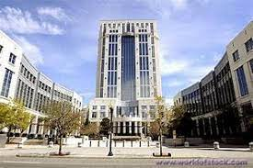
Welcome to the Orange County Contracting Academy

Slide 3
Academy Sessions
8:30 – 9:30 | “Navigating the Procurement Process” | Carrie Mathes, Procurement Division
9:30 – 10:00 | “E-Procuremement Platform Demonstration” | Adam Butler, OpenGov
10:00 – 10:15 | Break
10:15 – 10:45 | “M/WBE Program Overview” | Vasantha Raysor, Business Development Division
10:45 – 11:45 | “Insurance & Bonding” | Susan Martin, Risk Management Division (Cheryl Foley), Florida Surety
11:45 - noon | Q&A and Closing Remarks

Slide 4
Navigating the Procurement Process

Slide 5
Agenda
Tenants of Public Procurement
Website Resources
Public Meetings
Procurement Overview
Best Practices
Questions

Slide 6
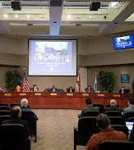
Tenants of Public Procurement
Transparency
Fair and Open Competition
Impartiality
Integrity
Fiduciary Responsibility

Slide 7
Website Resources

Slide 9
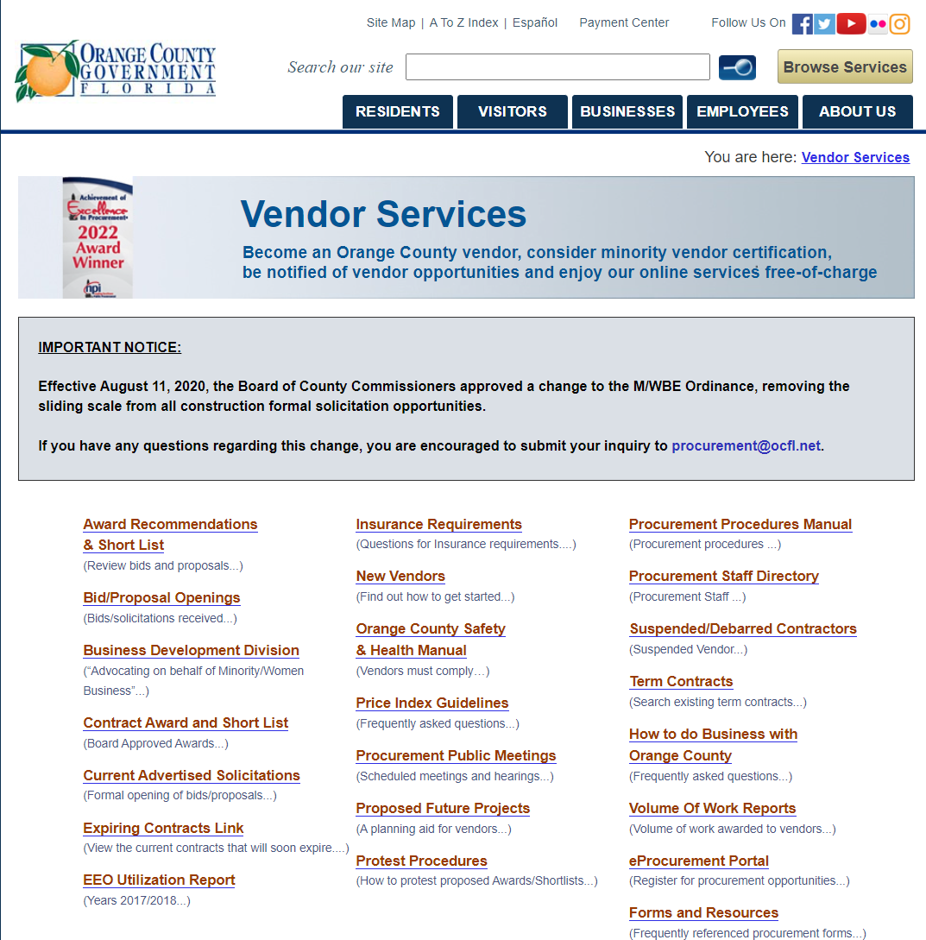

Slide 10
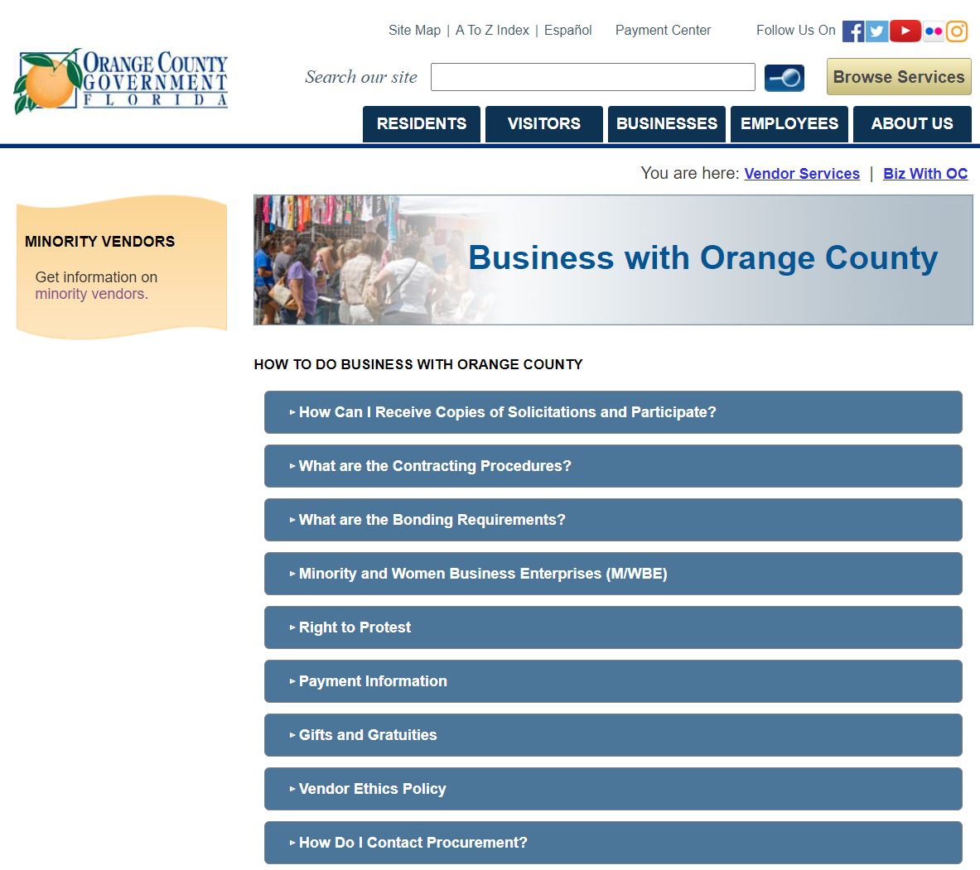

Slide 12
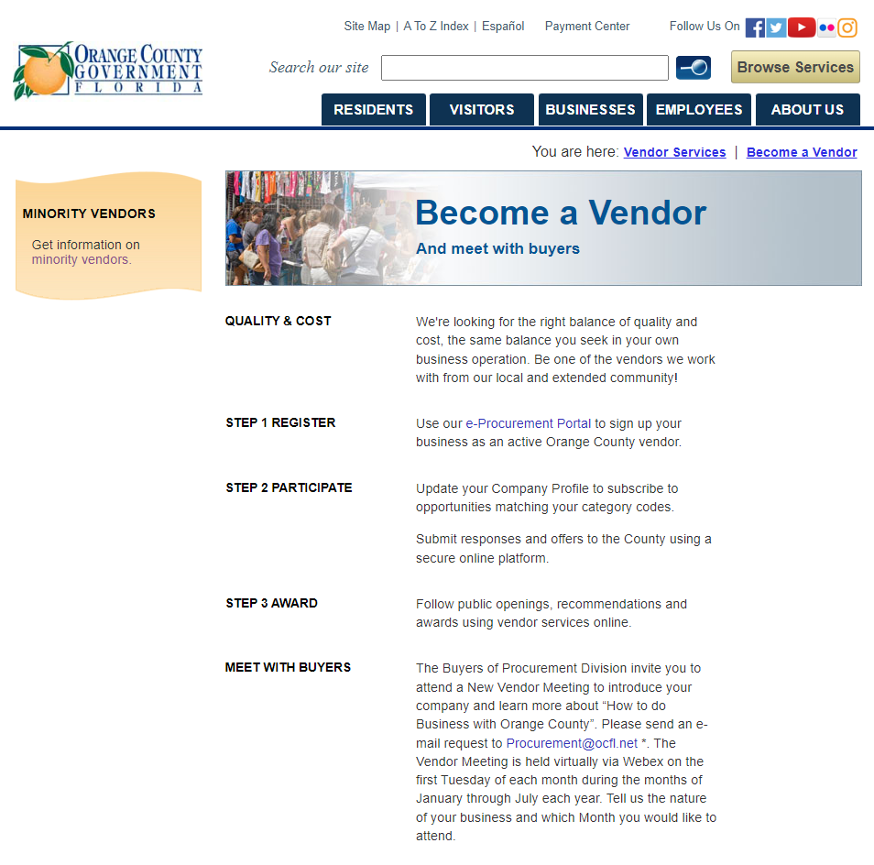

Slide 14
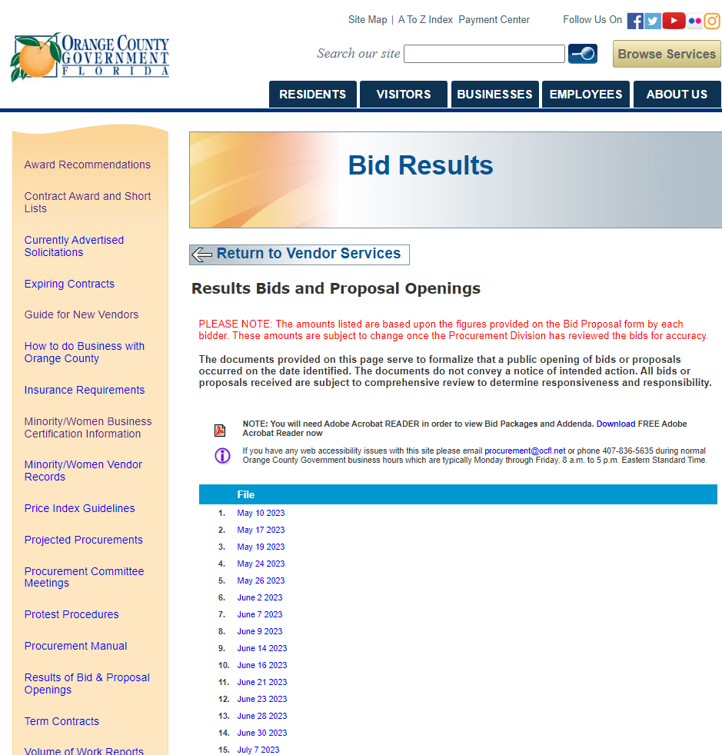

Slide 15
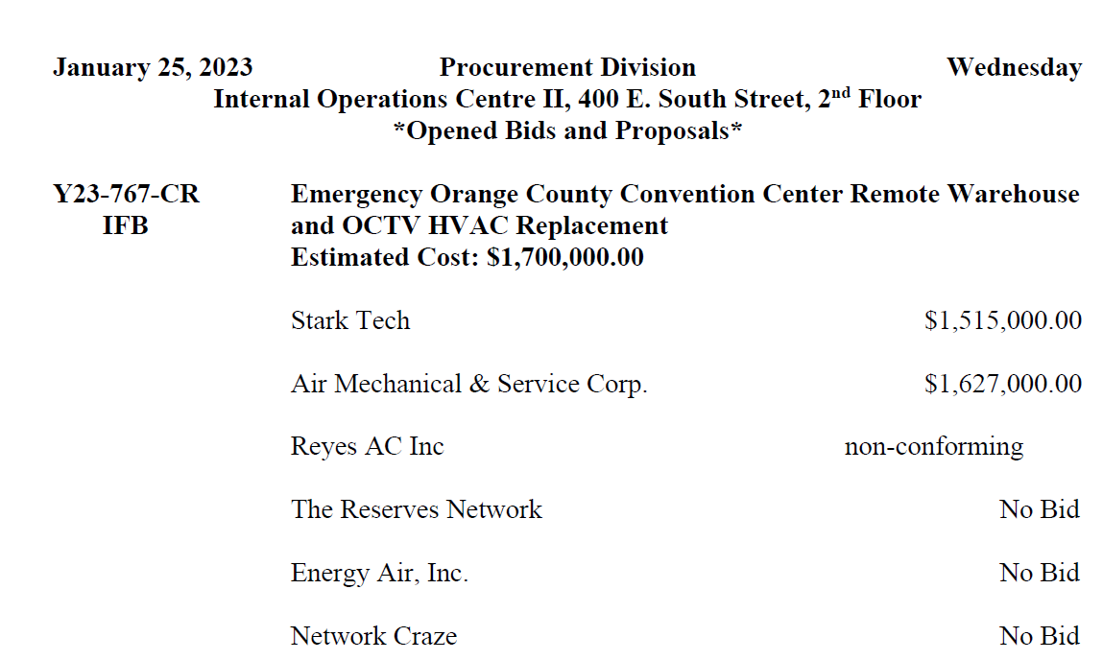

Slide 17
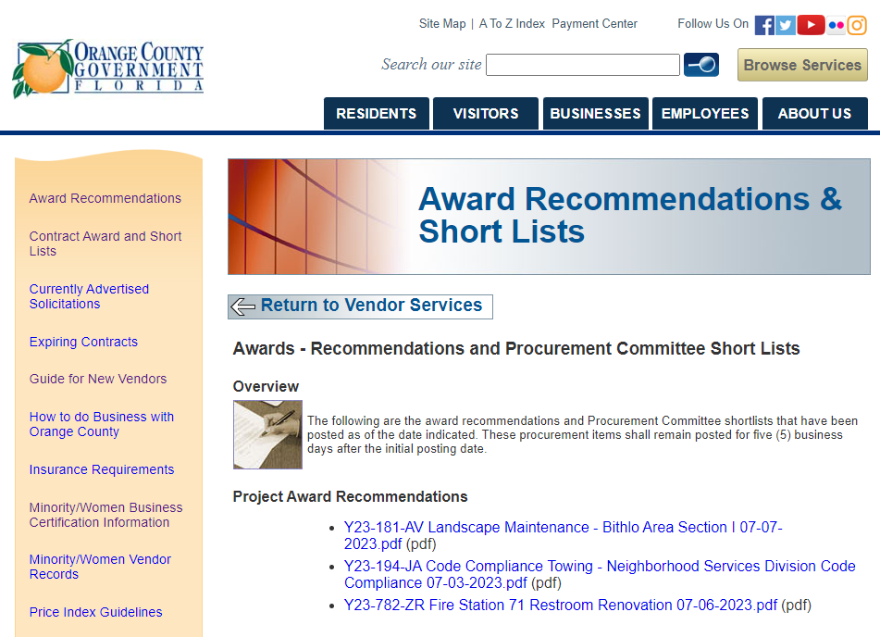
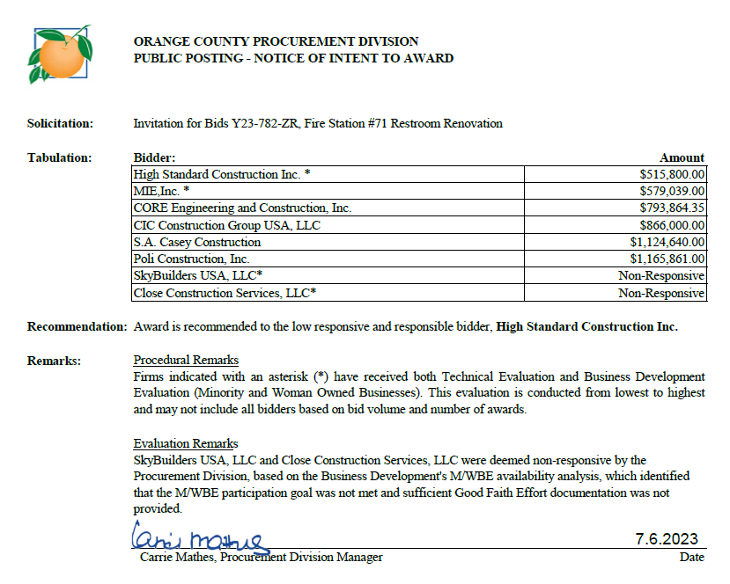

Slide 18
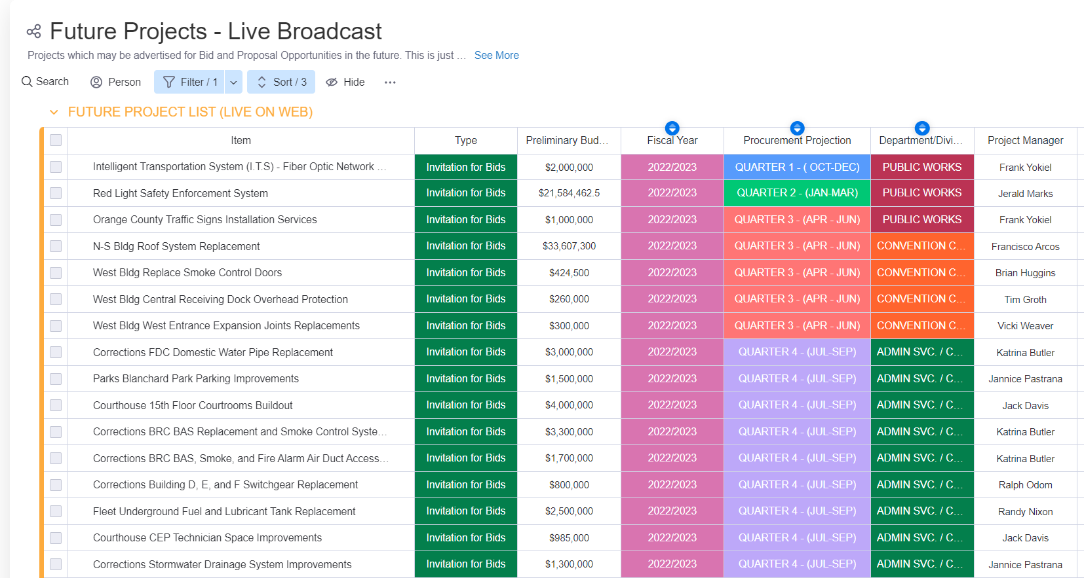
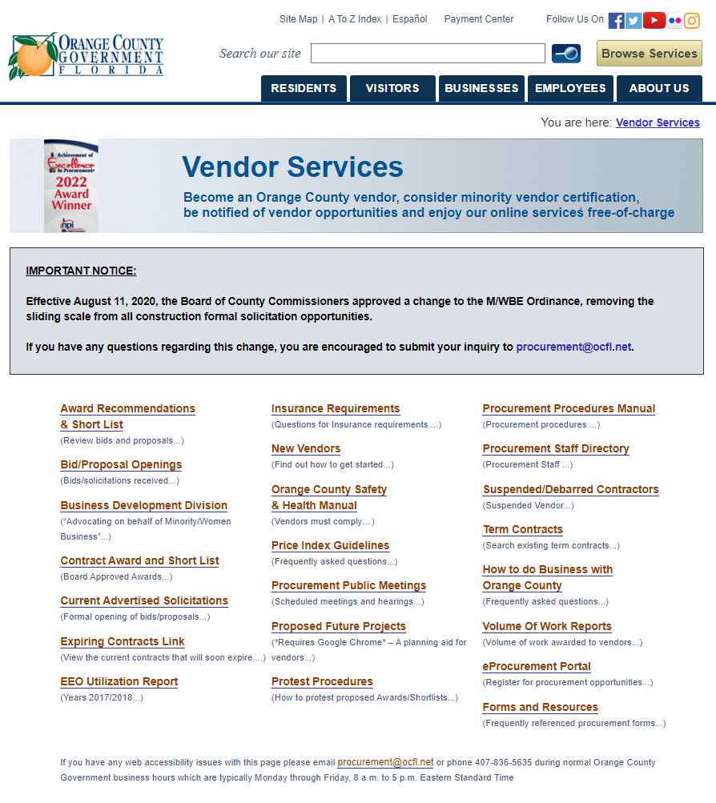

Slide 20
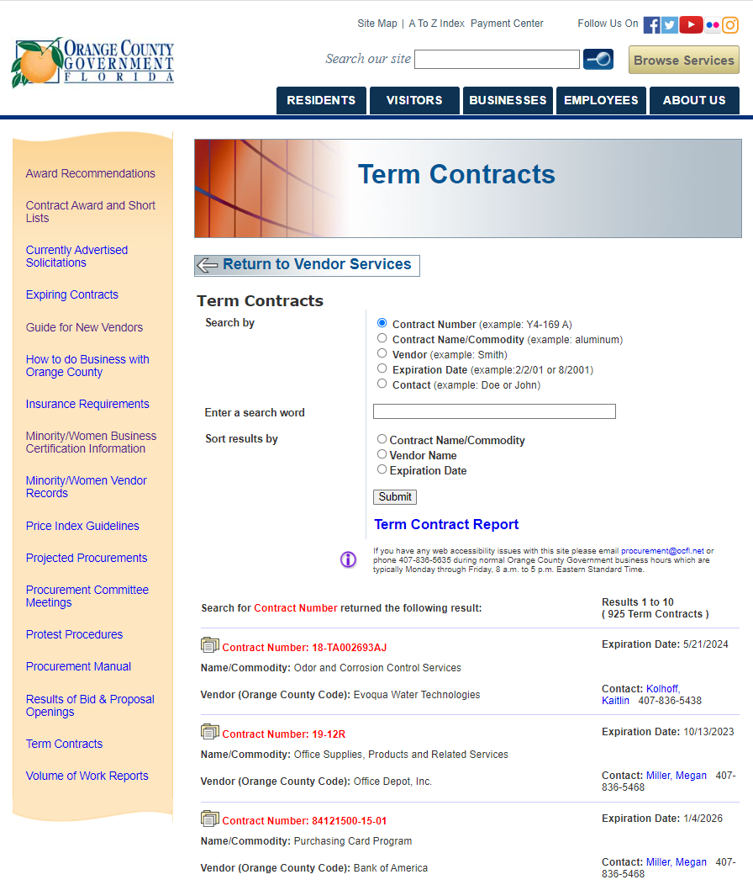

Slide 21
Public Meetings
Bid Openings – Wednesday and Friday
Procurement Committee – Wednesday*
Public meetings posted on County’s Calendar of Events at least 72 hours prior to meeting
Meeting minutes are posted in accordance with Administrative Regulation requirements
Final scores posted on website in accordance with Procurement Ordinance

Slide 22
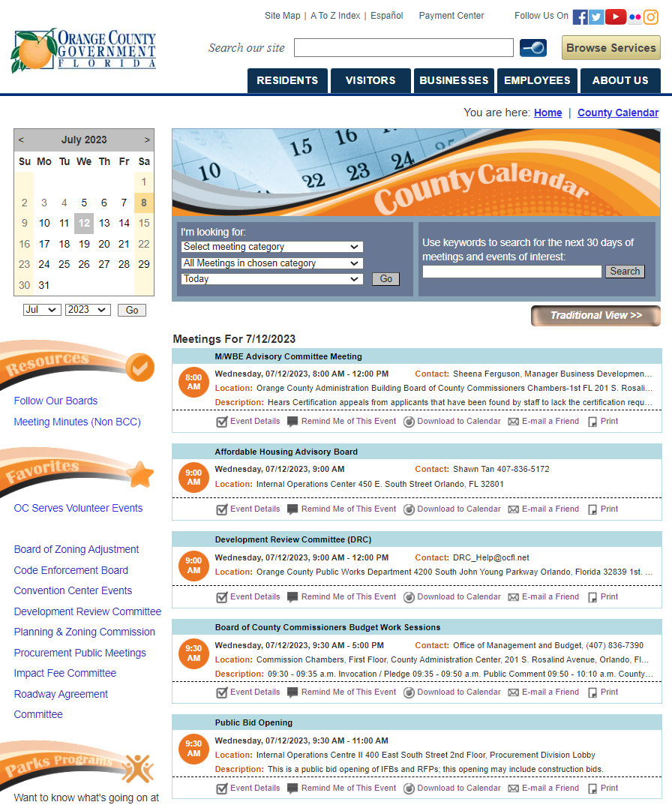
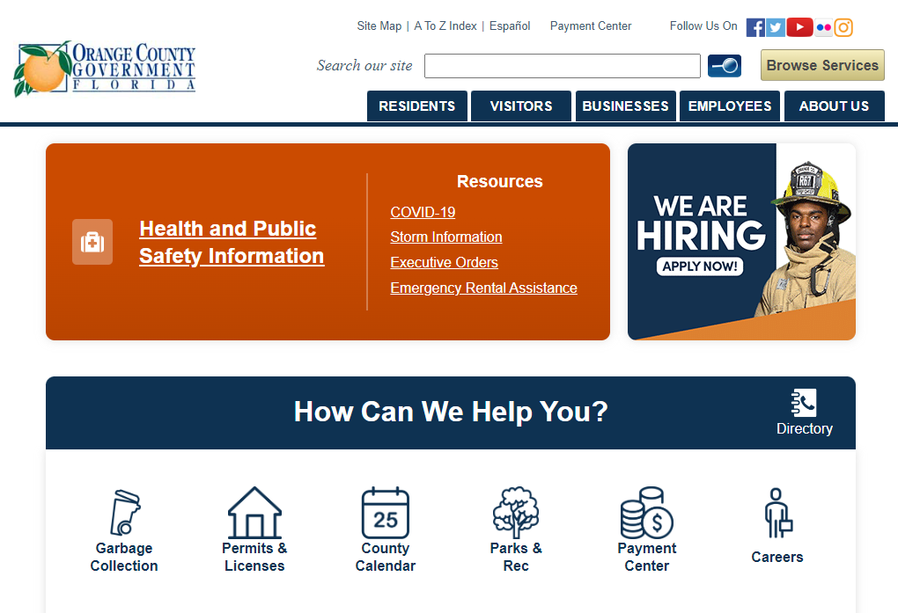

Slide 23
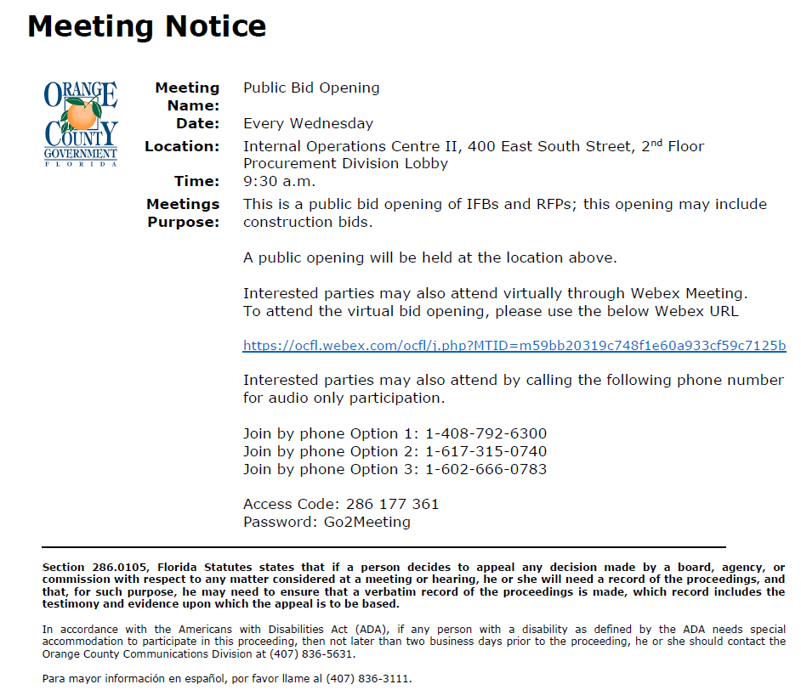

Slide 24
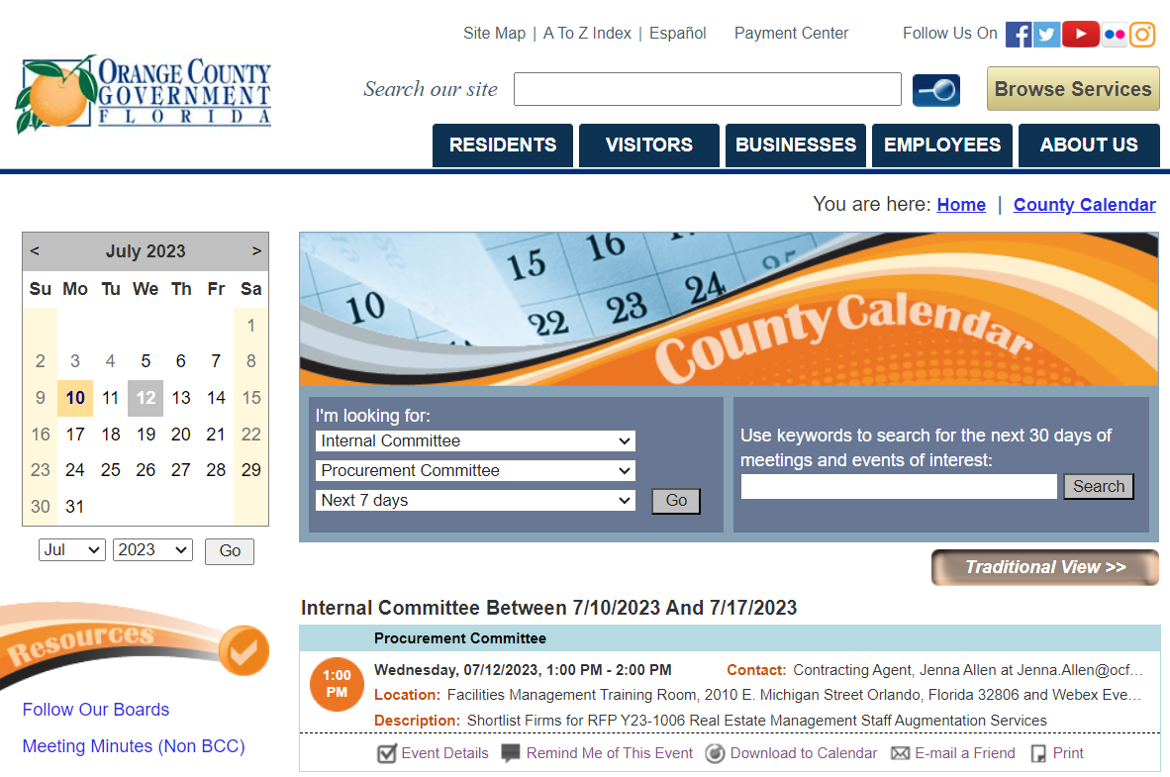

Slide 25
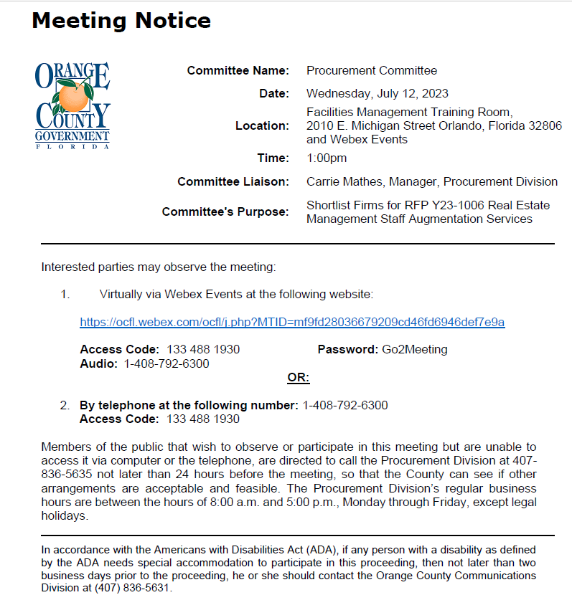

Slide 26
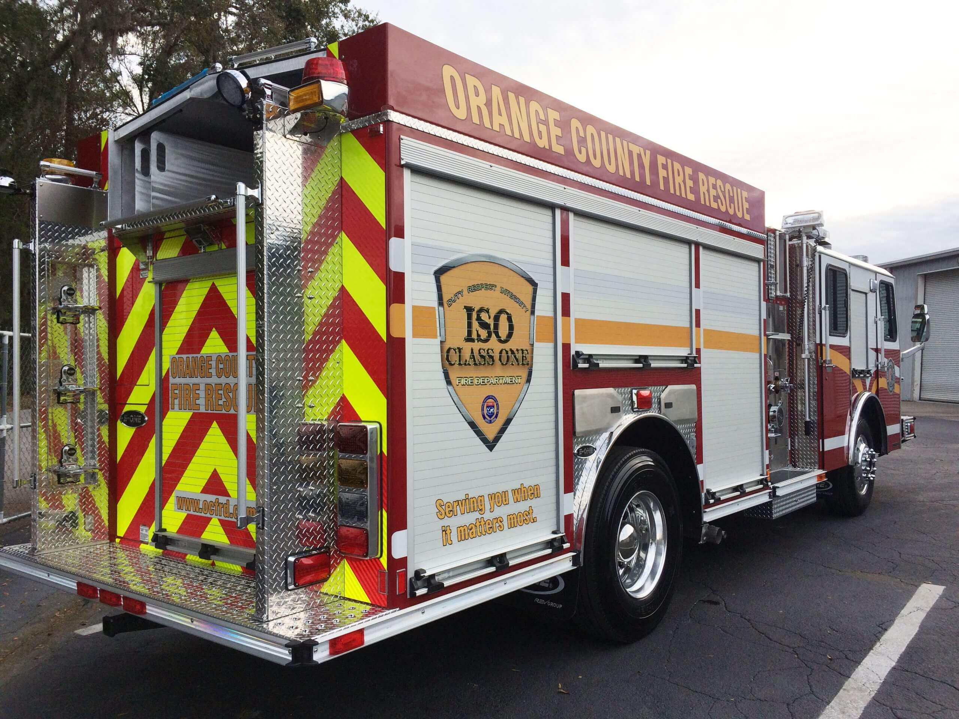
Procurement Overview

Slide 27
Procurement Operations
Centralized operation
Commodities, Services, Construction, Professional Services
Average annual contract awards - $650 million
Manage approximately 950 term contracts annually

Slide 29
Procurement Thresholds
Up to $10,000 | One Quote
$10,000 - $150,000 | Three Quotes
Over $150,000* | Formal Solicitation
Board approval is required for all procurements that exceed $100,000

Slide 30
Types of Procurements
Request for Quotations
Invitation for Bids (Formal Sealed Process)
Request for Proposals
Multi-Phase Solicitations
Sole Source/Emergency/Exempt
Alternate Contract Sources

Slide 31
Best Practices

Slide 32
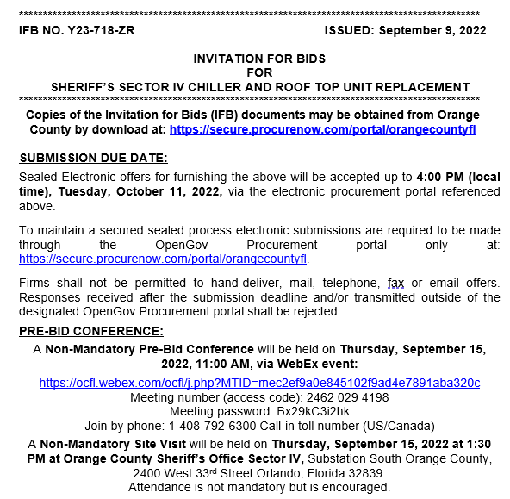

Slide 33
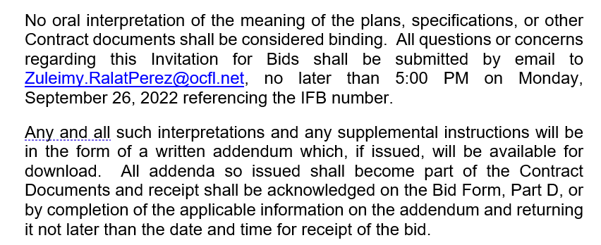

Slide 35
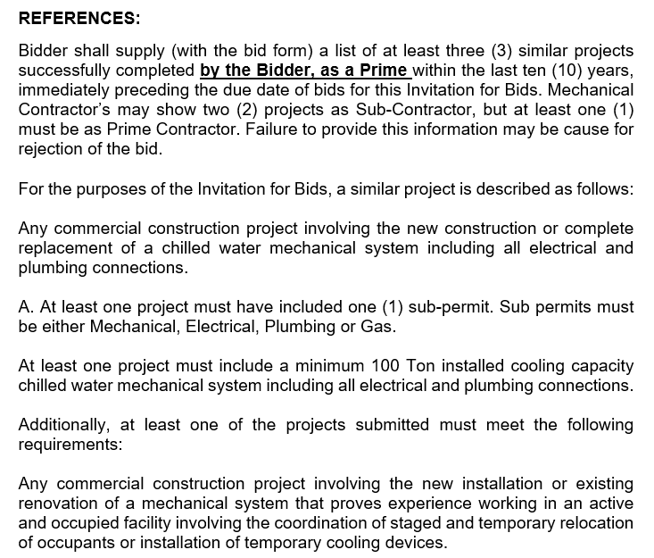

Slide 36
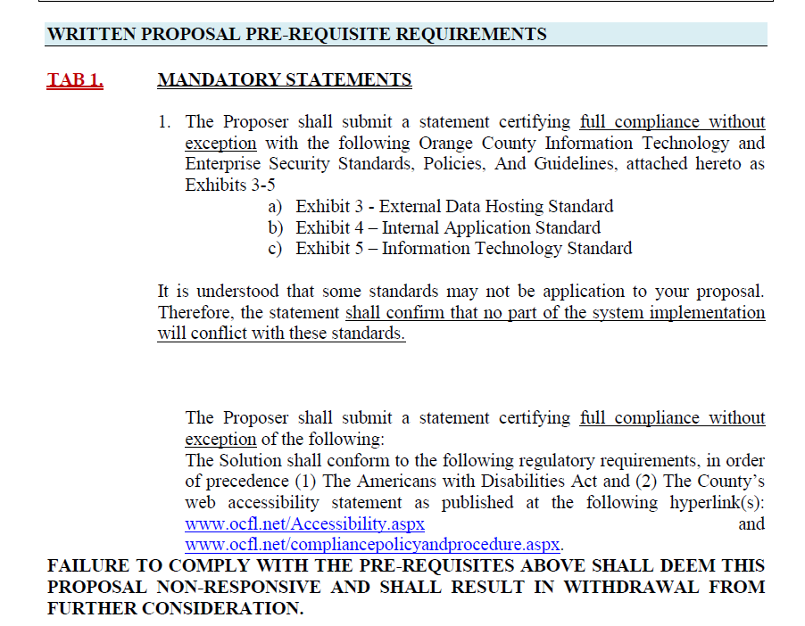

Slide 37
Your response constitutes a binding offer for the duration of the irrevocable offer period identified in the solicitation.
Avoid modifying submittal documents (pricing forms; bond forms.
References: Provide more than the minimum; inform references that you are including them in your submittal.
Adhere to formatting instructions and page limitations
Avoid adding terms and conditions

Slide 38
Review Draft Contract
Ensure all components are specifically addressed
Avoid assumptions - request clarifications
Confidential information requires citation to exempting law
Research current contracts

Slide 39
Submit all required forms, inclusive of addenda acknowledgements and M/WBE commitments
Ensure your price factors in all required insurance and bond requirements
Ensure upload occurs timely and completely
Withdrawals are allowed until the solicitation closing deadline

Slide 40
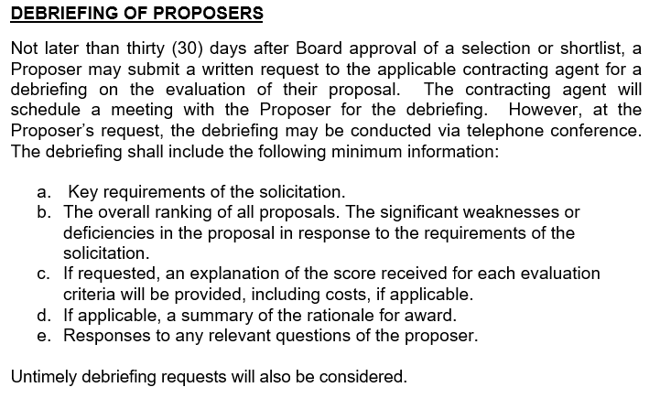

Slide 41
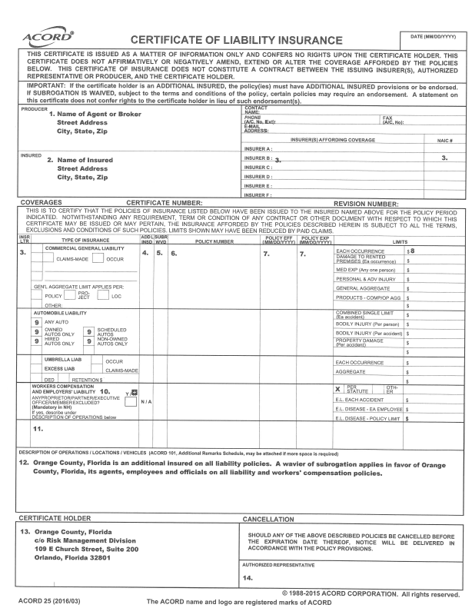
Compliance Requirements

Slide 42
Questions

